Slide 1
Lecture 26: the graphics module
CSC111: Introduction to CS through Programming
R. Jordan Crouser
Assistant Professor of Computer Science
Smith College

Slide 2
Announcements
As mentioned on Slack, my Tuesday office hours this week are rescheduled to:
TODAY 2 - 3:30pm
I’ll also be available on slack / Google Hangout during Tuesday hours

Slide 3
Outline
Python packages (graphics)
A quick demo
Using python modules
Drawing pictures with graphics
About the final project
Animation
Lab: Fish Tank
Interaction

Slide 4
Some of you may know…

Slide 5
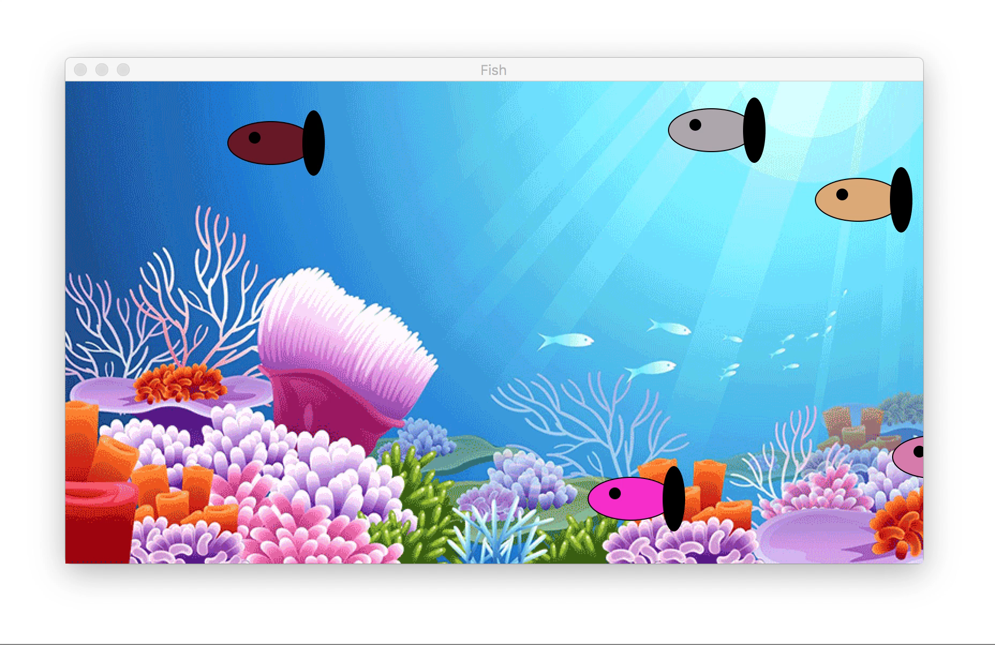
My in-office substitute

Slide 6

Discussion
How do you think they built that?
What components did they need?

Slide 7

1. Draw stuff
The images we draw are composed of marks: like ink
Lines
Points
Areas
…this is what today will be about

Slide 8
2. Make it move
…more about this Wednesday

Slide 9
3. Get input from the user and react
…more about this Friday

Slide 10
Hmm…
If these are the basic components of every game, it’s probably the case that someone else has had to build them before…

Slide 11
The graphics module*
Two kinds of objects:
stuff you draw (Graphics objects)
stuff you draw on (GraphWin objects)
Basic formula for drawing graphics:
open a graphic window (a GraphWin)
construct some Point, Line, Circle, Oval, Rectangle, Polygon, and Text objects
draw them to the window
close the window when you’re done
terminate the program
written by John Zelle to go along with his book “Python Programming: An Introduction to Computer Science” (Franklin, Beedle & Associates)
Available from: http://mcsp.wartburg.edu/zelle/python/

Slide 12
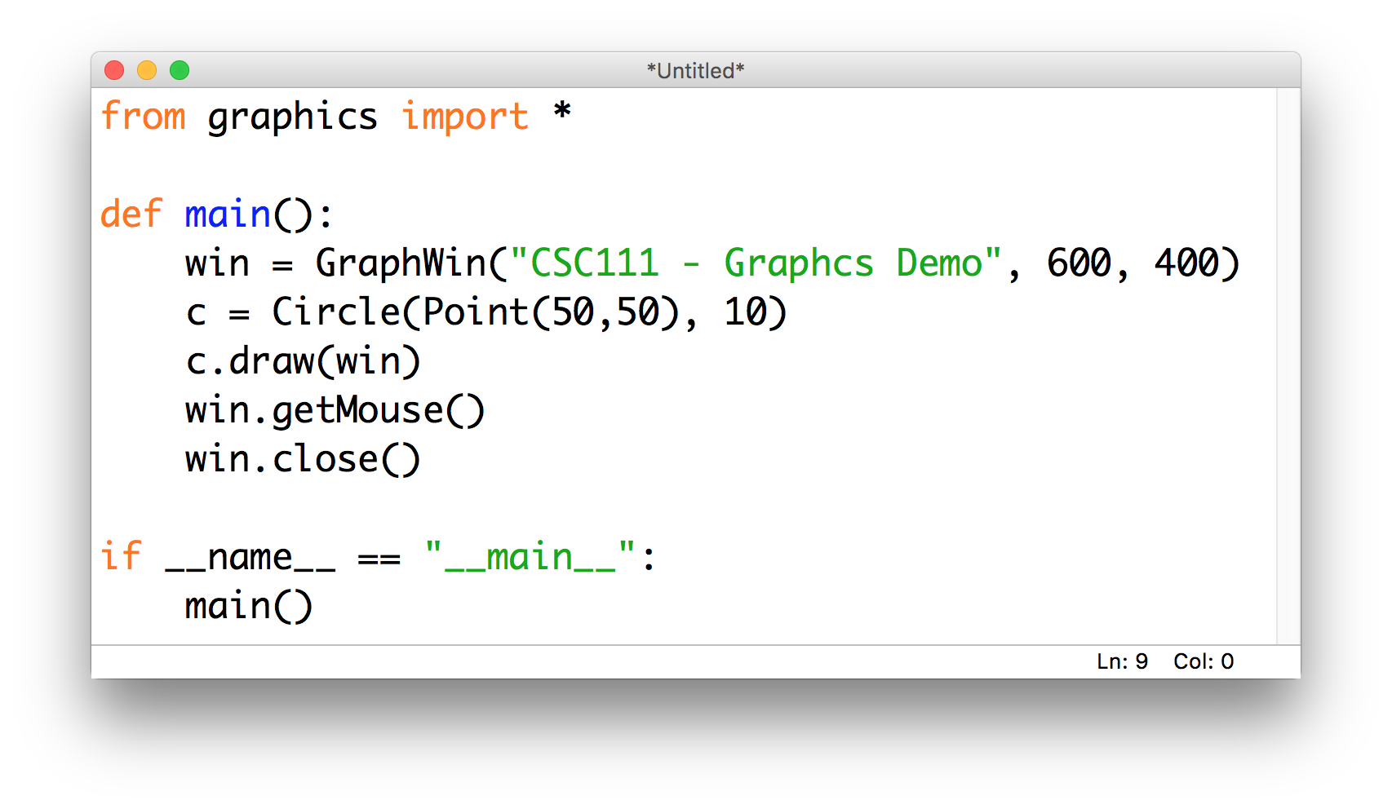
Our first graphics program

Slide 13
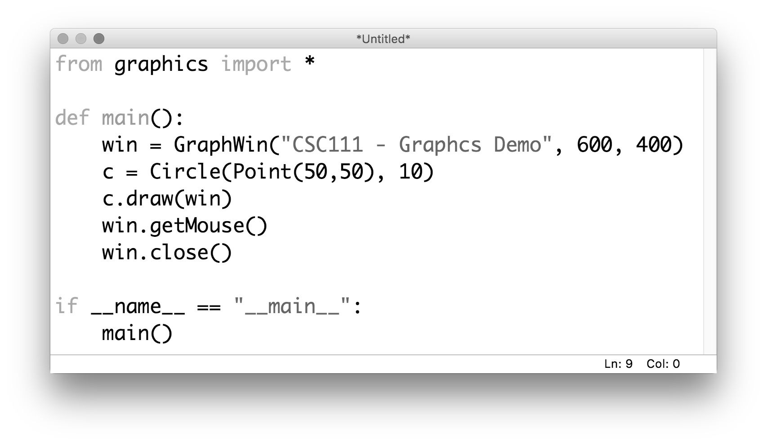
Our first graphics program
import the module
(this method means we don’t have to type
“graphics.” in front of every method)

Slide 14
Our first graphics program
build a GraphWin object
width
height

Slide 15
Our first graphics program
construct a Circle object
(centered at (50,50) with a radius of 10)

Slide 16
Our first graphics program
draw the Circle to the GraphWin

Slide 17
Our first graphics program
wait for the user to click
(so we can actually look at what we drew)

Slide 18
Our first graphics program
close the GraphWin

Slide 19
Our first graphics program

Slide 20
First “graphical primitives”

Slide 21
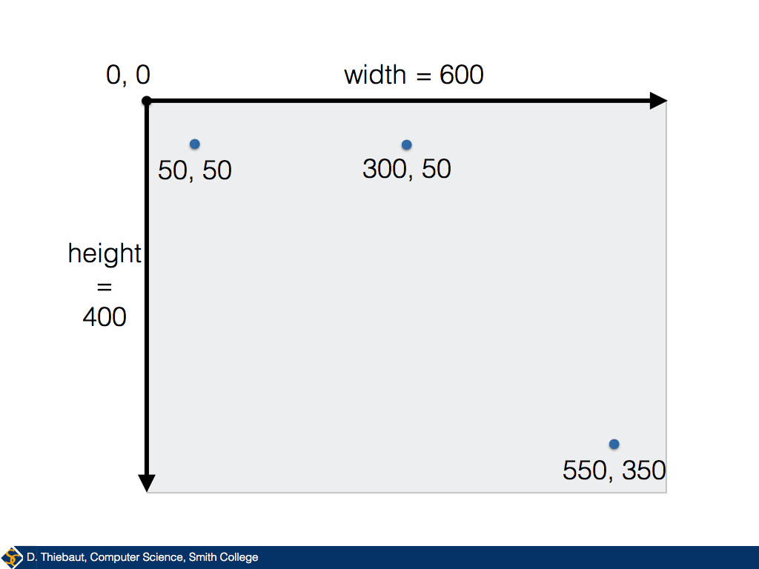
First “graphical primitives”

Slide 22
First “graphical primitives”

Slide 23
First “graphical primitives”

Slide 24
Filling an object with color

Slide 25
What if we want a more specific color?

Slide 26
Okay, let’s make a fish!
20px
5px
40px
60px
80px

Slide 27
Discussion
How can we get all of these parts
to work together?

Slide 28
Making a fish

Slide 29
Outline
Python packages (graphics)
A quick demo
Using python modules
Drawing pictures with graphics
About the final project
Animation
Lab: Fish Tank
Interaction

Slide 30
About the final project
Four weeks of class left! (time to talk about the final)
Goal of the project: apply the techniques we’ve learned in this class to something you care about
Ideas:
an computer-generated animation
a custom game
a tool to help plan your path through the major
a poem generator (expanding Lab 5)
a choose-your-own-fractal program (expanding Lab 7)
a graphing calculator program (expanding Assignment 2)
anything else you can think of!

Slide 31
Final project deliverables
Sunday Nov 18th: Final Project Proposal
Sunday December 2nd: Prototype I
Monday December 10th: Prototype II
Wednesday December 19th: Final Write-Up

Slide 32
FP1: final project proposal
Names of people working on this project
What's the big idea behind this project?
What are the (major) building blocks the project will need to be successful?
Which do you know how to build already, and which ones do you still need to figure out?
Are there any potential roadblocks?

Slide 33
Coming up next
Python packages (graphics)
A quick demo
Using python modules
Drawing pictures with graphics
About the final project
Animation
Lab: Fish Tank
Interaction

